Slide 1
Ecology and green energy
Czech Republic

Slide 2
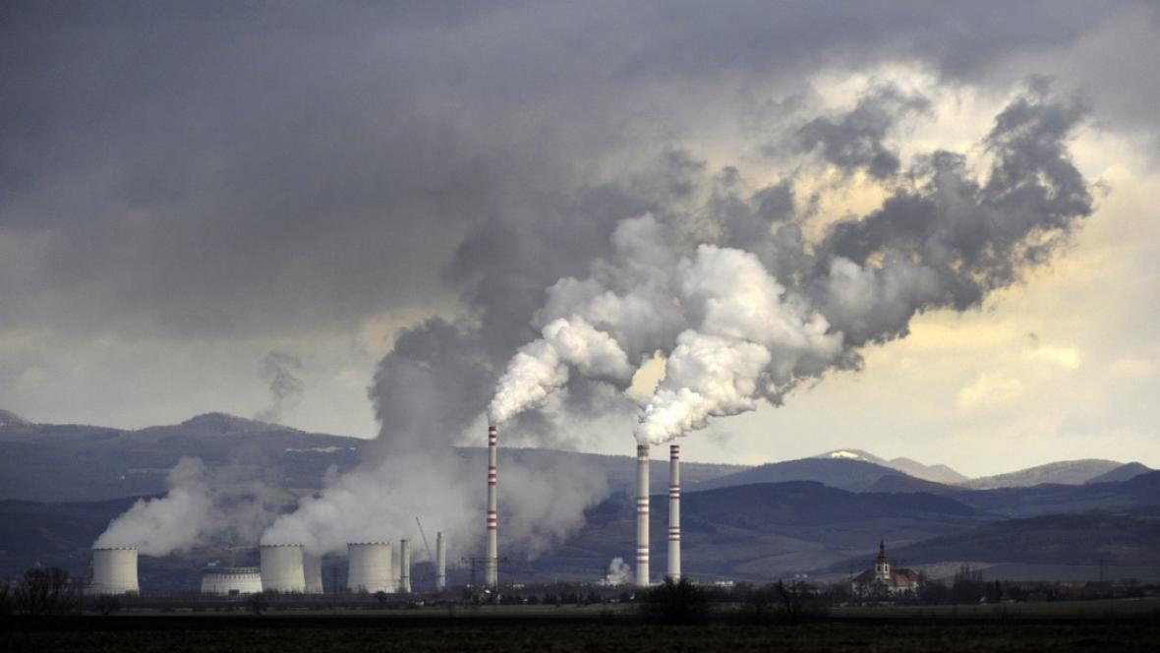
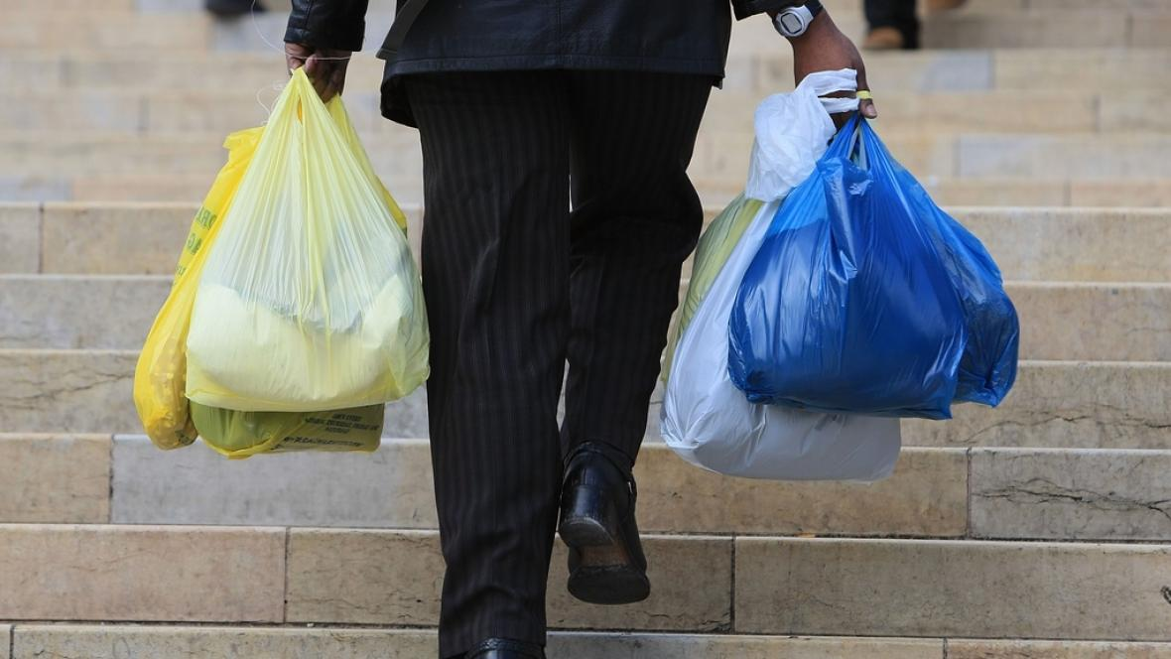
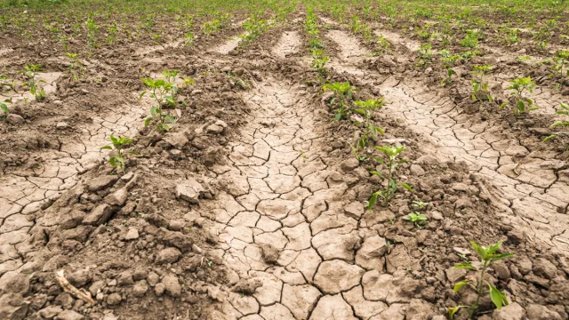
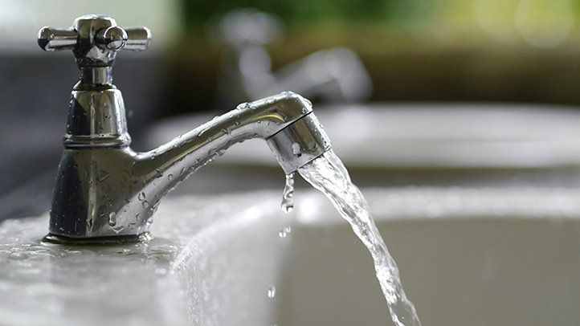
ENVIRONMENTAL PROBLEMS
01
03
02
04
AIR-POLLUTION
DISPOSABLE PLASTICS
DROUGHT
WATER SAVINGS

Slide 3
What does the Czech Republic do for the environment?

Slide 4
01
AIR-POLLUTION
Green energy and transport

Slide 5
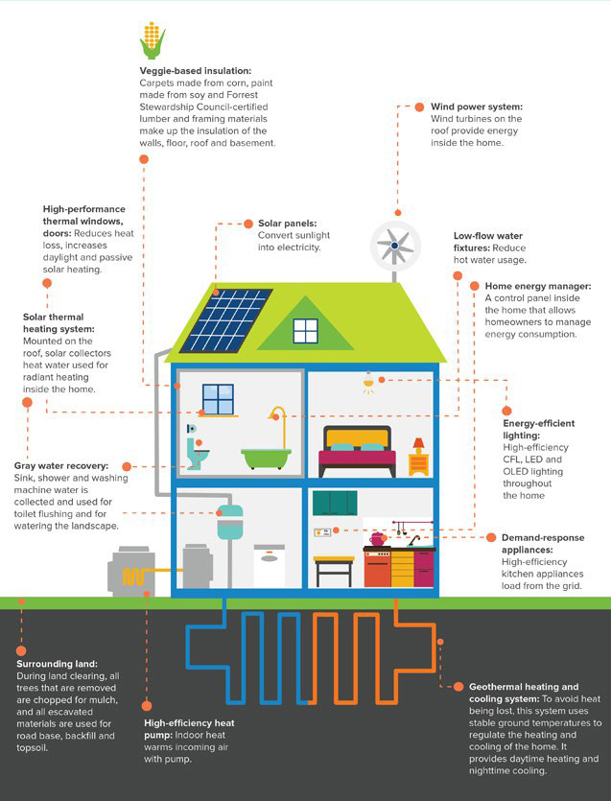
HERE IS THE SLIDE TITLE!
Green energy
Zelená úsporám - programme by Ministry of the Environment of the Czech Republic - supports building low-energy houses
Inventing more eco-friendly methods in industry

Slide 6
RENEWABLE SOURCES OF ENERGY
WATER
WIND
SOLAR RADIATION
BIOMASS, BIOGAS
GEOTHERMAL ENERGY
LIQUID BIOFUELS

Slide 7
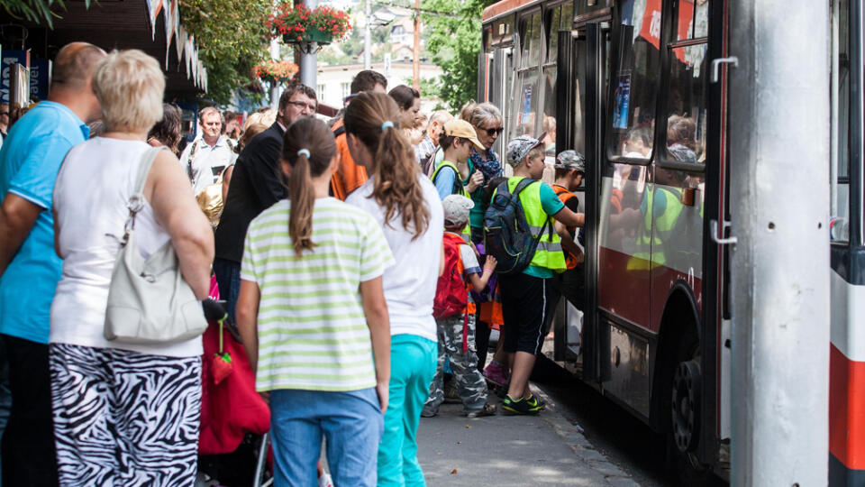
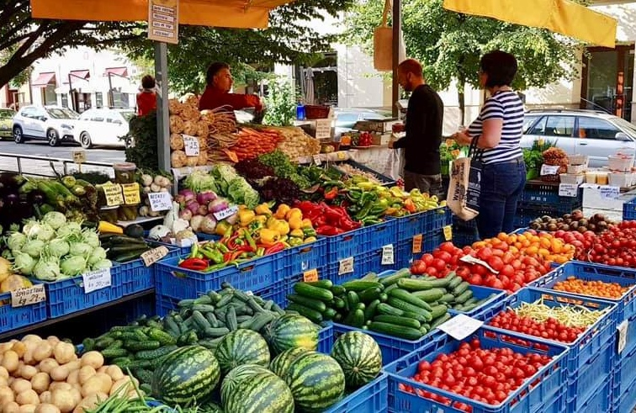
TRANSPORT
Donated public transport for students and elderly people
Supporting local brands and businesses

Slide 8
02
DISPOSABLE PLASTICS

Slide 9
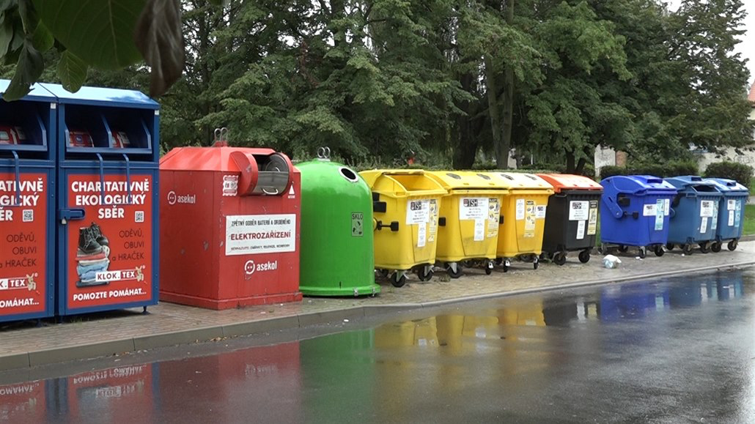
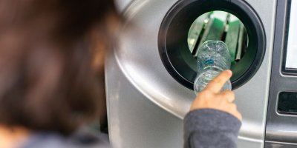
HERE IS THE SLIDE TITLE!
Disposable plastics
recycling
recycling bins
glass bottles returns
payed bags

Slide 10
ENVIRONMENTAL ORGANIZATIONS

Slide 11
THANK YOU FOR YOUR ATTENTION!

Slide 12
SOURCES
Giving-Priority-Fundraising-Needs-banner.jpg
Prague_1.jpg
Drought.jpg
4a26b9eb7308c8a1a0239acb784351c3.jpg
Net-zero-home-of-the-future-infographic-2.jpg
Jarvis_5f61117f498e75f68edc5fa2.jpeg
Image

